Slide 1
Recruitment & Retention
Quidditch Australia Strategic Forum 2020 – Workshop
Ajantha Abey

Slide 2
Branding
Recruitment
Retention
“Getting them in the door”
Passive Recruitment
Online Presence
Image
What you “Happen across”
Active Recruitment
Building Awareness
Overcoming Barriers
Advertising / Marketing
Public Outreach
Conventions / Media / Stalls
“Keeping them in the room”
Engagement
Community
Motivation
Notes:
Clarification of Terms
Two parts to growing quidditch:
Recruitment
All about getting people in the door
Raising awareness, advertising, marketing, PR, outreach
Convincing people to actually show up to a thing
Retention
All about keeping people in the sport
Once they show interest, how do we maintain their interest and engagement?
Split session into these two themes generally: (Recruitment + Retention), plus some things I want to talk about regarding branding/marketing/central messages

Slide 3
Woolworths
Coles
Notes:
Case Study - Woolworths and Coles
What is a brand?
Exercise: what do you associate with Woolworths? Coles?
Woolworths
Quality
Fresh Food People
Health
Green, Sustainability
Logo - apple (health)
Coles
Cheap, affordable
Down down
Prices are down
Homebrand
Logo - same red as Maccas, KFC, hungry jacks; all lower case, very simple
Two companies doing the exact same thing
Very very different brands
The brand is more than just the name and the logo
Everything we associate with it is the brand
It’s identity, character
It has to do things that are in keeping with its brand/character
Minishop - terrible idea
Woolworths seed packets - brilliant idea

Slide 4
What is a brand & Why do I need one?
Not just a name, not just a symbol
“The intangible sum of a product’s attributes”
Public perception of the entity
Identity / Character / Persona
Not just a corporate thing
Personal Brands
Social Movements
Clubs, Teams, NGBs
Quidditch
Recruitment → All about selling your club’s / quidditch’s brand
Passive: Creating Presence → Creating Your Brand
Active: Advertising / Marketing → Promoting Your Brand
Therefore, in order to recruit effectively, quidditch must have a brand
(if you want to sell a product you need a product to sell)
Too many teams try to market themselves without having a clear brand/character/identity first - problem
Notes:
What is a brand and why do I need one?
More than just a name - associations and public perception
Public perception and associations of a thing
Why Do we care about branding?
Not just a corporate thing - branding is everywhere
You have a personal brand
Your personality, your identity, what makes you up and how you present yourself to the world in your online presence, the clothes you wear, the jokes you make, the causes you support, the things you’re passionate about, this all forms part of a personal brand
Side note - marketing is therefore one of the most valuable skills you can learn, in understanding how to present and sell your own personal brand, be it in a job interview or in general social situations, as well as understand how you are being marketed to
Social movements also can be thought of as brands - feminism, environmentalism has a brand, civil rights movement has a brand, veganism, plant-based diet is vegaism rebranded
Quidditch teams have a brand - their culture, their identity, their attitude, everything that makes the team what it is is that team’s brand
And the idea or the sport of quidditch is a brand too
So today: Re-thinking Quidditch as a Brand, and Recruitment as Selling That Brand
Brand implies some kind of product, that product is now going to be quidditch
And so we break down passive and active recruitment into
Passive recruitment - creating the product to sell, making the product as sellable and enticing and desirable as possible
Active recruitment - marketing and advertising of that product
So therefore, if we want to recruit effectively, we can’t just start with active recruitment and advertising and marketing.
We have to start by creating the product, or creating the brand
This is essential because too many teams just rely on the brand of ‘quidditch’
Quidditch is not a good brand?

Slide 5
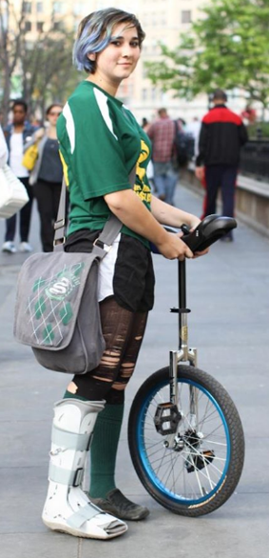
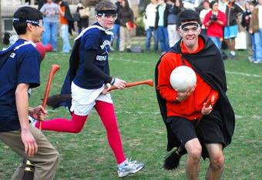
What is Quidditch’s Brand?
Notes:
What is Quidditch’s Brand?
It’s not good Jim
Not a good public perception
Not a very sellable product
This is the perception/brand we’re trying to fight against/rebrand
When we create a brand for QA/your club, this is the idea that we are trying to shake

Slide 6
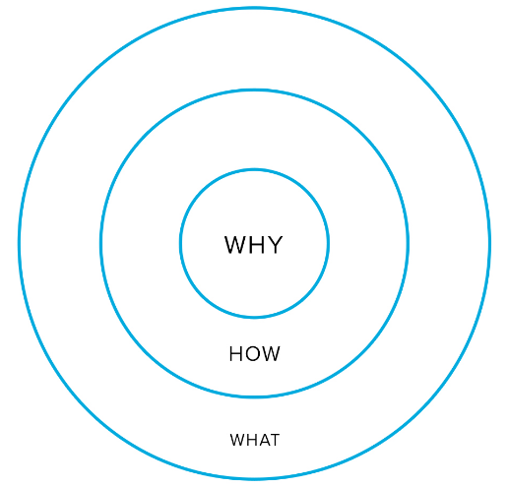
How Do You Build A Brand?
Purpose
Purpose – why do you do what you do?
Method – how do you do what you do? What differentiates you?
Product – what do you do?
Competitors
Other Teams – Gain Inspiration, Differentiation
Other Sports – What makes quidditch different?
Audience
Whom does quidditch appeal to?
Whom do we want to recruit?
Voice / Character
Personality vs Professionalism
Visuals
Logo, Tag Line, Hashtags, Colour Palate, etc.
All This Before Building Awareness / Marketing / Culture Building
Notes:
How Do You Build A Brand Part 1 - Golden Circle
First step in building a brand is finding a purpose
Not going to spend a long time on this because we kind of did it yesterday
Purpose is all about working out why your product, quidditch, exists in the first place, what’s it for, why do we do it
The thing I want to mention here is the idea of the golden circle
For any brand there is a what, a how, and a why
Most advertise in that order
Most effective advertising goes in the reverse order
This is all over the internet, you can look it up yourself, TED Talk - Simon Sinek
Main Point: The Why is the most important thing - that has to be at the centre of your brand
Because really it’s the centre of your identity
What - we play a sport. Not that interesting.
How - it’s quidditch. It’s different because it’s inclusive and stuff. Kind of interesting.
Why - mission statement, values, motivation - community, competition, friendship, fun, etc.
Example - coles and woolworths. Their what is identical. They differentiate on the how and the why.
Eg - my brand name may be usyd quidditch, but the actual brand is built around making friends, building community, having fun, striving to challenge and push yourself.
This is the first step in creating your team’s brand - working out the why.
How Do You Build A Brand Part 2 - Competitors
Step 2 in creating a brand is then looking at other organisations with the same what as you, and learning from them and differentiating your brand from theirs
Quidditch’s competition?
Other quidditch teams
Try and differentiate - e.g. Valks and Nightmares.
Gain inspiration - e.g. tufts quidditch
I follow tonnes of quidditch pages and groups
Trying to gain inspiration, see what other teams do
Favourite - Tufts. Very simple branding, very effective.
First impression - cover photo. Wholesome. I already like them.
Power of smiling faces
Colour scheme - unusual colour of blue. Distinct. Easily identifiable.
See throughout posts just by using jerseys, not even with photoshop
High level of brand identification
What is their brand? What is the identity of their club they are trying to sell?
Group of people, having fun
Group of friends, fun loving, quirky
Close knit community
Tactics
Lots of community engagement
Memes
Challege a tufflepuff - totally works with their quirky, fun loving brand
Remarkably little actual quidditch photos on the page - predominantly showcase their players, smiling, having fun, messing around
Everything about their page says “this would be a really fun bunch of people to be a part of”
This is very effective
Other sports
How is quidditch different from other sports?
These are all valuable things to work into your brand and advertising
Gender Diversity
Affordability
Community
Inclusivity
Culture
Way of working out what to sell yourself as / how to forge your identity - through differentiation from other similar brands
How Do You Build A Brand Part 3 - Audience & Voice
Next part of building a brand for your club is working out who your audience is
If you know whom you’re marketing yourself to, you have a better idea of how to present yourself to make yourself more appealing to a target demographic
QUESTION: whom is quidditch appealing to?
Correct answer: People with a sense of adventure, willingness to try new things
E.g. exchange students, first year uni students
Need to try and expand beyond this, appeal to wider audiences, but also enhance this first one
QUESTION: what kind of person to do want to recruit?
Exchange students and first year uni students? Absolutely. Greatest potential for time to be able to commit to quidditch.
People who align with our values.
Need to try and expand beyond this
Therefore: What voice do we use?
Club
Appealing to young people, students
‘Down with the kids’
Be energetic, have personality, use memes, showcase your club’s culture
QA
More professional, some character, but it’s hard for corporate bodies to pull off ‘down with the youth’ type social media
IQA tried memes once, it was bad
How Do You Build A Brand Part 4 - Product Creation Not Marketing
NOW, once you have fleshed out the persona, the character, the identity of the club, can you start creating visual representations and start looking at things like logos and hashtags and other ways to represent the club like colour palete etc.
Visuals just work to aid and cement all this
C.f. woolworths and coles - logo/brand/colours should represent your brand
Critically, this isn’t recruitment yet
This is all just creating the product, this is all building the brand
This is all before we start trying to build awareness and advertising it
We need to create the product before we try to sell it

Slide 7
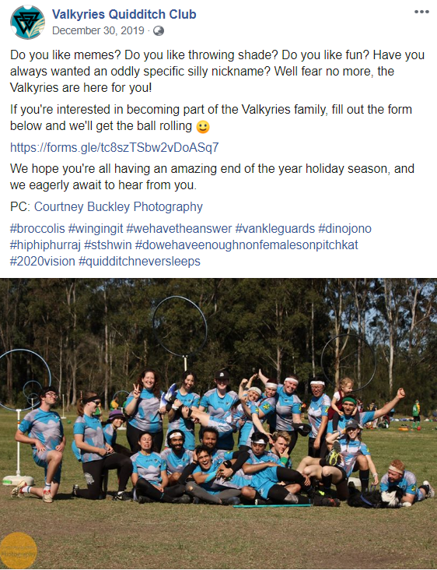
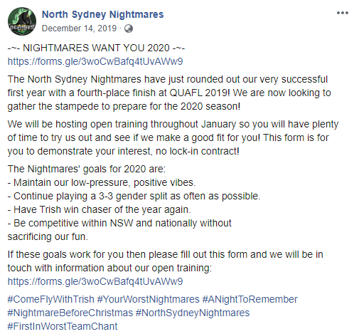
Notes:
Case Study - Valkyries vs Nightmares
So applying this to a quidditch context quickly, in a practical sense, I thought we’d examine two teams as a case study in effective branding
Starting with Valks - what is their brand?
Fun group of friends
Lots of hashtags - demonstrate things like
In jokes - sense of camaraderie
Easy way to demonstrate club culture
Leave you wanting to know more and wanting to be part of it
Broccolis
Melon lords
Don’t even talk about quidditch or playing or competition
Group photos
Nightmares
Memes and nonsense
More generic than the Valkyries in-jokes
Random meme-y photos
Lots of generic puns
More competitive
Mitigate this by showing that they don’t take themselves too seriously
Both
Have wacky, not too serious chants
Exercise their brands in person
Valkyries - female empowerment - one of few teams with unironic female keeper, top female goal scorer
Likes coles and woolworths
Their “What” is exactly the same
Both graduate teams, started at the same time, recruiting from the same generation players, same competitive attitude, same location even
They’re completely distinct teams and identities and brands, nevertheless
Both trying to differentiate from existing Serpents brand

Slide 8
How Build A Brand – Social Media, Online Presence & Consistency
Easiest (and most important) place to build a brand – online
Facebook, Instagram, other social media
Website
Everything needs to be in line with your brand
Hashtags, taglines, core values and key ideas always being restated
Social media presence demonstrates/creates the persona of your brand
https://issuu.com/uonquidditch/docs/brandbook_final
Same colours online as in person – makes things recognisable
Live your brand
What is the Point? All of this is Passive Recruitment & Creating a Marketable/Desirable Product.
Notes:
How To Build A Brand - Online Presence & Consistency
Brings me to the next point of creating a visible product
Now that we have created a brand / product / idea, it needs to become visible - it needs a presence so that
People can find it - passive recruitment
We can show it to people - active recruitment
Obviously the easiest place to build this is online
Use platforms like social media and websites - showcase the identity (brand) of your club
Everything you post needs to be on brand
Hashtags
Always reiterating core values
Whenever you post something, consider:
How does this represent the WHY of my club
How does this portray the persona / character / culture of the club
What you post about your club not only reflects your culture but creates it
Posting things online is not about advertising most of the time - it’s not active recruitment. It’s creating an image, a brand, a product, a representation of who you are as a club that you can point to.
CONSIDER: Why do clubs post their results from QUAFL? Why do recap posts?
Create and build a brand
Keep social pages active
Live your brand
Brands don’t just exist online - you have to act in accordance with your club’s culture and values too
Your club’s brand should be based around what your club culture is by definition
Point of all of this is to create the product or brand that is your club and it’s image and reputation.
You are creating a marketable and desirable product
When someone stumbles across your club’s existence by accident, suddenly, your presence becomes an advertisement for you - it represents you and they are judging your club based on what they perceive online. Make sure the product that you have is good.

Slide 9
Social Media Presence
Dos and Don’ts from Tegan Diep
Notes:
Social Media Dos and Don’ts
Lots of the finer points of how to do this are all in the recruitment guide
List loads of ideas about the kinds of things you can post, how often to post, how to build up an image of club culture, etc.
Go read it yourself
Tegan is also here to help with some social media tips (see other document)

Slide 10
Recruitment
Part 1 – Building Awareness
Notes:
Recruitment:
So - now we’ve created our brand. We have a product, it’s marketable, it exists online and in the world in a demonstrable and findable way.
How do we make people aware that it exists?

Slide 11
How Do We Build Brand Awareness?
National
FB/Google Ads, flyers
State
Paid FB Ads
Club
Paid FB Ads
Individual
SEO
Merch
Come and Try
Come and Try
Spectator Guides
Teams (Google) Map
Standardised Proposals – schools, youth groups, churches, etc.
Promoting team locations
Collab with other sports
Convention Stalls
Outreach to passerbyers at tournaments
Actions: What Can We Make
Social Media
Video Platforms
YouTube
Public Spaces
Bulletin Boards
Public Events
Festivals
Facebook
Instagram
TikTok
Conventions / Sports Fairs
People
Merch
Word of Mouth
Partnerships
Local Businesses
Local Council
Business Cards
Public Media
Other Online Fora
MeetUp
Website/Google
Twitter
Newspapers
TV
Radio
Schools
O Week
Shopping Centre Stalls
Tournaments
Netflix
LGBTQ Fora, Mardi Gras
Big Sporting Events
Ki
Platforms:
Where Can We Put It?
Notes:
How Do We Build Brand Awareness (Discussion/Brainstorm)
10 minutes - just brainstorm ideas about
1. What different levels of organisation can do to help build awareness of quidditch and quidditch brands, be that a club, QA, or the sport itself
2. What platforms we can distribute this information on
I.e. what can we make to help advertise or promote our product, and where can we put it where other people will see and find it?
Note on SEO - actually fairly important
Demonstration - QA and USyd have very good SEO - usually first search result for “Quidditch” and “Quidditch in Sydney”
There are 1001 guides online about how to optimise SEO
Not just about potential players but about potential outreach opportunities
This is only half of it
This is just finding tools and places to promote the brand
We haven’t talked about presentation and content and marketing yet

Slide 12
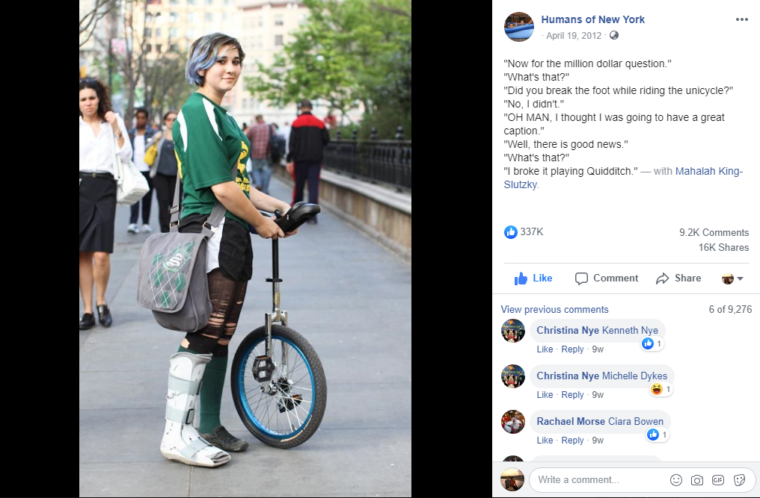
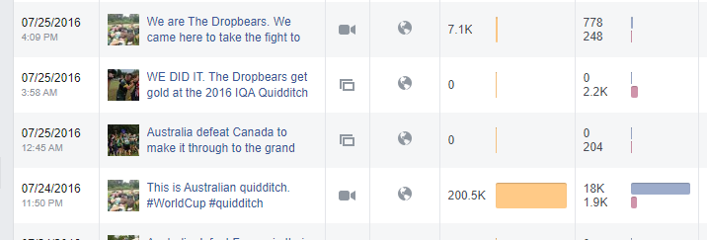
Notes:
Follow up point: Do we really have an awareness problem? Lots of people probably do actually know quidditch exists

Slide 13
Barriers to Quidditch – is Awareness Really the Issue?
Brooms
Cliquey
Not sport oriented
Shy
Too Complicated / Overwhelming
Being Full Contact / No entry level
Time
Convenience / Visibility
Fear of Stigma/Shame/Bullying
Age difference
Too Simple / Boring
Community/social vs sport
Venues (field hire / lighting / indoor – expensive)
Affordability
Notes:
Barriers to Quidditch (Discussion)
The broom? People seem weird? Too complicated? Too hard? Too borning? Too overwhelming? Not enough time? Inaccessible?

Slide 14
How Do You Make Quidditch Appealing?
Show off brand
Counter / Deconstruct Barriers
Intercept perceptions
Notes:
Not a long point
Combine the appealing aspects of quidditch (all a part of your brand and values and mission etc) and try to mitigate/counteract the barriers
Mostly about making your brand and advertising partly about enhancing your character and partly about breaking down the barriers and misconceptions identified

Slide 15
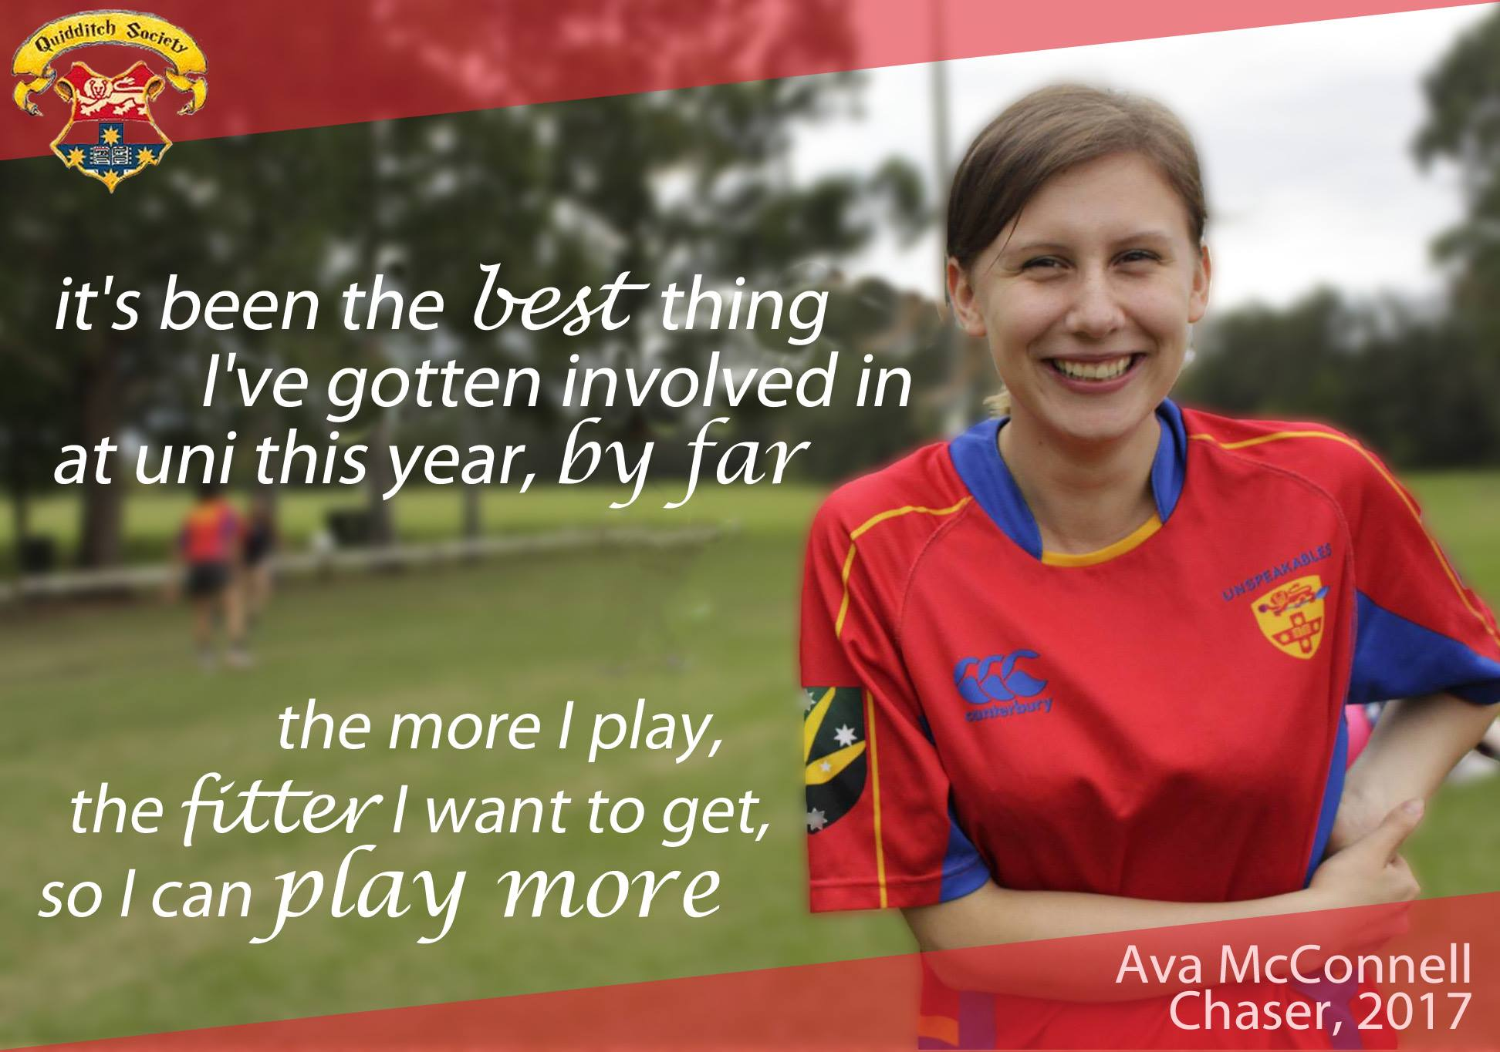
https://freshsparks.com/successful-brand-building-process/
Notes:
Individuals Driving Awareness / Testimonials
The most powerful way to raise awareness - word of mouth
Why companies care so much about leaving reviews
You can create tonnes of awareness online, but what actually brings people over the line, what breaks down barriers, is actually showing real people, either in person, or online, and showing their authentic opinions on the quidditch brand
Most people become aware of quidditch through online media
Most people actually come to training because someone convinced them to

Slide 16
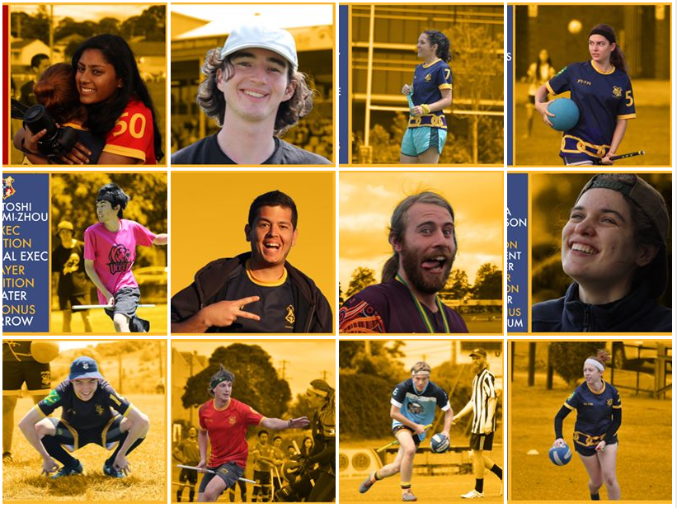
Diversity Is Critical

Slide 17
Retention
How Do We Keep People In The Sport?

Slide 18
What Motivates You? Why Do People Leave Quidditch?
Friends / Connection / Community
Strong connection to team mates
Personal Goals – on and off pitch
Leading by example
Opportunities to make a change / difference
Responsibility / Obligation
“If I don’t do it, who will”
Investment / Passion in the club/idea
Belief in the idea/brand of quidditch
Community support / mental health support
Feeling a part of something
Time – people move on
Full day tournaments is a big time commitment
Injury concerns
Unfair Match-ups in games
No “alumni” system
Bad personal experience / bad eggs
Abuse of power in clubs
Bad Sports / Bad Impressions
Immaturity
Toxic Masculinity
Extroverted vs introverted dynamics in teams
Bad experiences as referees (with bad eggs) – referee abuse
Personal development for players is lacking outside of elite level
People don’t talk about these things
Burnout / Being overworked /
What do you do when you’ve achieved your goals?

Slide 19
How Do We Improve Retention?
National
State
Club
Individual
Divisional QUAFL?
Cross-divisional games
Motivational
Participation
More flexibility in division system
Looking at membership data for potential problematic trends
Create Positive Experiences
Promote Positive Culture
Give People Goals / A Drive / Aspirations
Managing Complaints and Player Attitudes
Exit Survey
Notes:
Focus on community, building relationships
What makes people travel for an hour to run around in a park, in the cold and wet and rain and mud, with a stick between their legs?
What motivates you? How do we motivate people? (brainstorming session)
Pride (jerseys)
Friends
Obligation
Competition
Achievement
Health / Fitness

Slide 20
Bonus Optional Extras
Exclusive Look at USYD Quidditch’s 2017 Strategic Plan
Q&A about Recruitment Guide Topics
Usyd Quidditch home page analysis
Q Consultancy – PR Resources (qconsultancy.org/resources)
What do you want to see on the new QA Website?

